Slide 1
Better Together:
Citation Recommendation Proposal
Peter Vickers (University of Sheffield)

Slide 2
Scope
High Level Questions:
What makes a good (citation) recommendation? What does the user actually want? Are these the same questions?
What are the existing models from SciRepEval-like tasks that we can build from?
How can we assess Citation Recommendation better, if we accept that authors do not always make the right choices for their citations?

Slide 3
Motivation
My work has been on multimodal- classification or retrieval.
External Knowledge VQA, Text-Image Retrieval, etc
Proposal for JSALT: Work on the text-conditioned retrieval tasks
Link Prediction for Recommender systems: what should I read? what should I cite?
Search / Rank Retrieval / Relevance Feedback: given a query (text and/or documents with relevance labels): find documents in the collection that are similar to the query.
Summarize collection of documents: compare and contrast clusters (as opposed to summarizing each document in isolation)

Slide 4
Citation Recommendation
Given that our context training (either ProNE or GCNN) occurs on citations between papers, Citation Recommendation appears to be the paradigmatic task.
From BT Proposal: “The cite prediction task provides pairs of document identifiers with titles and abstracts. The pairs are labeled with 1 or 0, indicating whether the first paper of the pair cites the second member of the pair or not. The task is to predict the label.” -> Binary prediction task
Datasets: scirepeval, ACL Anthology (all CompSci)
Is this task similar to what people actually want? (probably not)

Slide 5
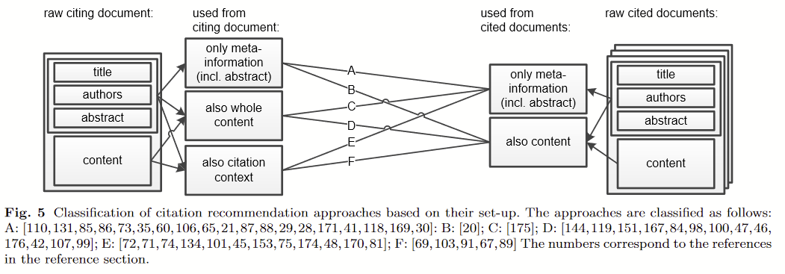
Citation Recommendation
Citation recommendation: approaches and datasets, Färber & Jatowt (2020)

Slide 6
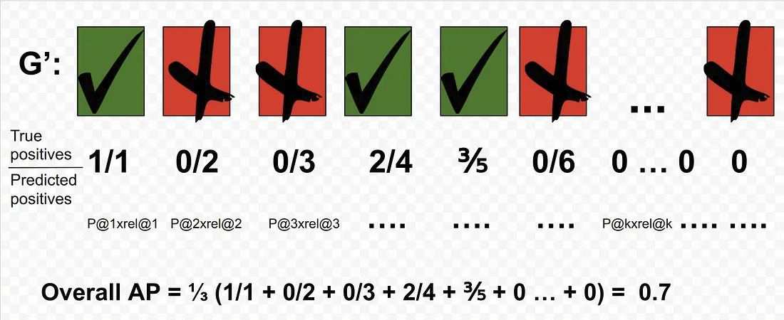
Citation Recommendation
SPECTER’s Small Set Citation Recommendation Task
“[Small-set] citation prediction task provides document identifiers with titles, abstracts, and 5 citations masked. The model is given 25 candidate papers and asked to pick which of the 5 are correct”
Done through Nearest Neighbour Retrieval in the encoding space, giving a ranking.
Therefore, evaluate using a ranking metric (MAP, nDCG)
From
https://towardsdatascience.com/breaking-down-mean-average-precision-map-ae462f623a52

Slide 7
Local Citation Recommendation
I suspect paper recommendation from only title+abstract will be very poor
From Better Together proposal: “Can we do something more interesting? “We plan to take advantage of additional features (citations, citing sentences and full text) in a way that is robust to missing/corrupted values.”
> Add more signal with paragraph embeddings - Local Citation Recommendation
E.g. FullTextRead dataset from A context-aware citation recommendation model with bert and graph convolutional networks (Jeong 2019):
Right_citated_text,left_citated_text,source_abstract,source_author,source_id,source_title,source_venue,source_year,target_id,target_author,target_abstract,target_year,target_title,target_venue
X16.7k

Slide 8
Citation Recommendation
Presume we have all papers cited in our collection (extremely strong assumption, may have to evaluate on a subset of papers). We do have 120M papers.
Can we try an open-set ranking task?
“Generative citation prediction task provides document identifiers with titles, abstracts, and 1 citations masked. The model is asked to find the missing paper”
Metric: Mean Reciprocal Rank (= MAP if only 1 relevant item)

Slide 9
Implementation for open paper recommendations
Local_Text_emb = SPECTER(Title, Abstract)
Citation_emb = GCNN(All-but-1-citations)
Predict Citation:
argmax_i( cosine_sim ( Local_Text_emb, Spectre(Title_i, Abstract_i) )+
cosine_sim ( Citation_emb, GCNN(Citations_i) )
Where i is an index in our paper collection

Slide 10
Citation Recommendation
How to handle valid candidates y_hat which aren’t present in the paper and are related to true paper y? “Relaxed citation re-prediction”
Relative Co-citated Probability: replace a score of 1 with some discounted score (e.g. 0.5) if a Co-citated paper is recommended instead. Can we use cociation rate as a better signal?
Use cocitations to smooth the reward (White 1981):
Cociation score(x_1, x_2) =
sum(papers which cite both(x_1, x_2))
How to normalize the score?
Cocitation_normed(x_1, x_2) =
sum(papers which cite both(x_1, x_2)) /
sum(papers which cite(x_1))

Slide 11
Full Citation Recommendation
Push the idea further: Can we recommend all citations for a paper?
Same assumptions as before (all cited papers in collection)
“Generative citation prediction task provides document identifiers with titles, abstracts, and all citations masked. The model is asked to find the missing papers”
New issues:
With graph-based embeddings, we’ll want to update the embedding as we predict new citations
However, low numbers of citations may give unstable graph embeddings.
How to know when to stop adding citations? (Unfair to expect model to know how many citations)

Slide 12
Full Citation Recommendation
Solutions:
Predict papers 1-by-1 and add them to the graph embedding
Learn dummy embeddings before we have enough citations
Decoding paper recommendations
Treat paper recommendation as a decoding task.
From 0 citations, predict the most likely citation, then add that to the paper representation.
Then repeat previous step until some criteria met
Beam search will probably help

Slide 13
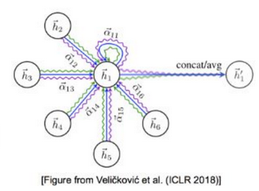
Handling Low Citation Count
Generalise: Can we start GCNN(Other_Citations) with very few citations?
We would expect to see out-of-distribution effects with >10 citations
Idea - ‘Prompt learn’ dummy citations to fill in the first 10 citations when generating embeddings. Similar to Factual Probing Is [MASK]: Learning vs. Learning to Recall [Zhong 2021] tor Learning to Prompt for Vision-Language Models [Zhou 2021].
For papers with fewer than (say) 10 citations, artificially insert 10-num_citations dummy citations into the graph with citation edges from the paper
These embeddings are updated with the Local citation prediction task and the value is shared across all papers.

Slide 14
Local Citation Recommendation
“Generative citation prediction task provides document identifiers with titles, abstracts, local text, masked citations from within the local text and all citations from outside the local text. The model is asked to recover the masked citation links”
Simulates adding a new section to a complete paper. Allows almost-complete citation context to play against local text context.
Can also become a text-query paper recommendation system -> just pass the model a sentence description for a paper you’d want to read. Perhaps citations could be a medelely collection.

Slide 15
Proposed Local Citation Model
Inspired by A LSTM Based Model for Personalized Context-Aware Citation Recommendation (Yang et al 2018):
Local_Text_emb = MLP_t(Spectre(Title, Abstract)+BERT(Citing Paragraph))
Citation_emb = MLP_c(GCNN(Other_Citations)+BERT(Citing Paragraph))
Predict Citation:
argmax_i(
cosine_sim ( Local_Text_emb, Spectre(Title_i, Abstract_i) ) +
cosine_sim ( Citation_emb, GCNN(Citations_i) )
I.e. Learn MLP_t, MLP_c to transform Text and Citation Embeddings within their respective spaces to attend to the local text
Train on labelled examples with Metric loss, use soft positives (cocited papers) to smooth loss

Slide 16
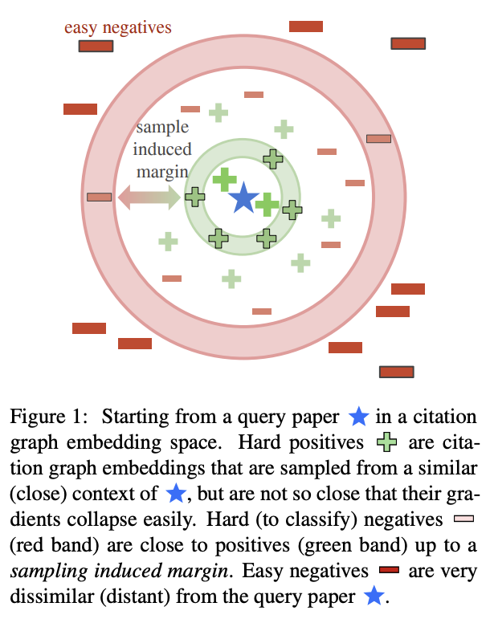
Leveraging Better Together
What do high quality document embeddings let us learn better?
Massive collection of documents embedded into the same space
Smooth signal when learning to predicting, e.g. loss of predicting wrong doc is cosine-distance(y, y_pred) in the embedding space (Neighborhood Contrastive Learning for Scientific Document Representations with Citation Embeddings, Ostendorff 2022) shows soft representations help with learning)
Assume better together gives us high(est) quality paper embeddings on a unit-hypersphere, can beat other models already

Slide 17
Soft citations
Philosophical Aside: Are we sure that the citations a paper uses are the correct ones?
The Foundation of the Concept of Relevance, (Hjørland 2010)
System’s view - What a model reports as relevant
User’s view - “Only the user themself may judge relevance”
Subject literature view - “What should be considered relevant means: To be considered relevant in scholarly arguments.”
Subject knowledge view - “Something is relevant in relation to a task if it supports the fulfillment of that task”
Which views make Figure 1 acceptable?

Slide 18
Baseline Data
When will we have Better Together embeddings? (June/July/August 2023?)
Creating the datasets most likely the hard part
Existing datasets:
CORD-19, Covid-19 papers, Local Citation (Augmenting and Graph Scaling for Context-Aware Citation Recommendations, He 2020)
FullTextPeerRead, ACL papers, Local Citation (A Context-Aware Citation Recommendation Model with BERT and Graph Convolutional Networks, Jeong 2019)
We have access to ACL Anthology and arXiv, and also Social Science Research Network for social science papers.
Will need to parse papers to extract citing paragraphs + link citations to the graph indices used by the GNN team. May be a shared effort if citing sentences are a key concern.

Slide 19
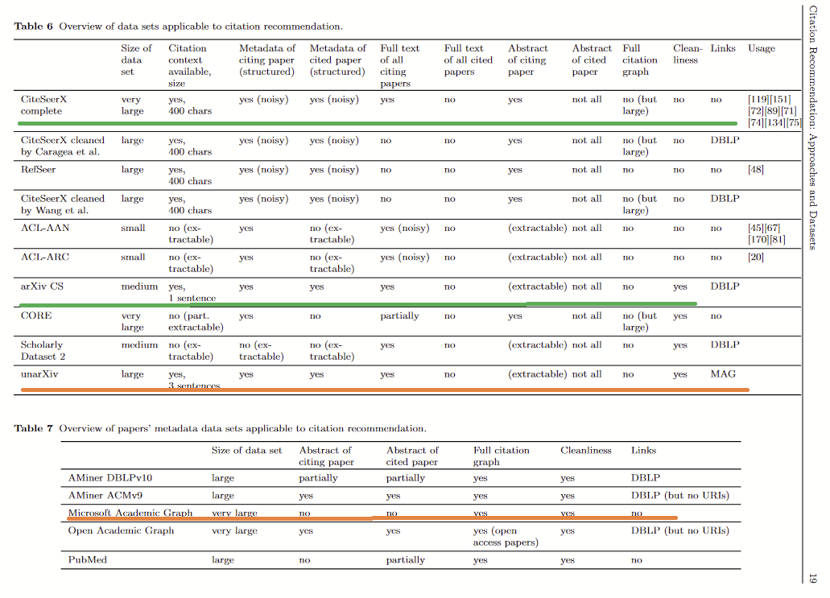
Making New Datasets
Citation recommendation: approaches and datasets, Färber & Jatowt (2020)

Slide 20
New data
Will need to transform datasets into task specific. Can follow Jeong et al to transform those we have full text for.
Can only cite papers we have embeddings for. Can we also add new papers quickly (i.e. what should we cite from 100M corpus + 10000 local paper collection)
Extension - Can we learn the reverse task? Given Title, abstract and local context with a citing sentence omitted, and that citation, can we predict the sentence?

Slide 21
Baseline System (Global Ciation Prediciton))
Step 1. Generate Better Together embedding from current citation list/title/abstracts
Step 2. Recommend most likely citations for a paper globally. Recursively repeat step 1 (beam search as including a citation on a key topic reduces the need for further citations in that area)
Question: Will better together be stable with few initial citations in step 1? Will dummy citations help? Question for GNN team

Slide 22
Other Applications of Recommendation Systems:
Uses for Soft citations:
What citations is this paper missing?
What are the top 5 salient citations of this paper?
Which citations should be here but aren’t (or are here but shouldn’t be)?
What might be citations to field X? (If this deep learning paper could only cite statisticians, what would it cite?)

Slide 23
Proposed Schedule for JSALT
Now - workshop start: Obtain paper data. Work on parsing into formats specified in this presentation.
First two weeks of workshop: build a system which relies on SPECTER and ProNE embeddings to recommend papers. Will require two ANN indexes and datasets. Set up both models for generating fresh embeddings when predicting.Try to beat SciRepEval task and then move to open setting
Second two weeks of workshop: Add GCNN embeddings. Work on the dummy embedding training problem with GCNN team. Reevaluate experiments with better embeddings. Set up any online evaluations.
Final two weeks of workshop: Work on local citation recommendations. Can be closely aligned with other teams if working on paper recommendation.

Slide 24
Scope
High Level Questions:
What makes a good (citation) recommendation? What does the user actually want? Are these the same questions?
Depends on our view of relevance. If we base our systems on citations, we reflect a subject literature view.
We don’t know what the user wants. Perhaps the user is wrong anyway.
What are the existing models from SciRepEval-like tasks that we can build from?
Simplest: NN lookup. More interesting: condition on a text context (citing sentence etc)
Decoding setting for multiple paper citation. Issue of summy embeddings.
How can we assess Citation Recommendation better, if we accept that authors do not always make the right choices for their citations?
Yes, a key advantage of citation-based systems is that embeddings will align with papers with second- or higher- degree citation links
If we take the assumption that authors are not correct in their citations, we can offer new citations, or even add cross-disciplinary ones

Slide 25
Discussion

